Slide 1

FOURFLIX – A NEXT-GEN OTT PLATFORM
©️ TEAM FANATIC 4 Diploma 6th sem CSE CITK

Slide 2
FOURFLIX OVERVIEW
01
01
PROJECT BRIEFING
02
OBJECTIVES & GOAL
A short overview of the project by - Merina Baro
Brief of the purpose of our project by – Soumik Das
03
DEVELOPMENT CYCLE
04
LIVE DEMO
In-Depth go through of the making process by - Raaj
LIVE working demo of our website by – Teresa Basumatery

Slide 3
ABSTRACT
FourFlix is a content sharing platform where people can share their own content and make it discoverable to their audience. The core concept of FourFlix is to provide individual content paging for every uploader while staying server- free/low maintenance and make it stand out from the crowd being a discrete entity.

Slide 4
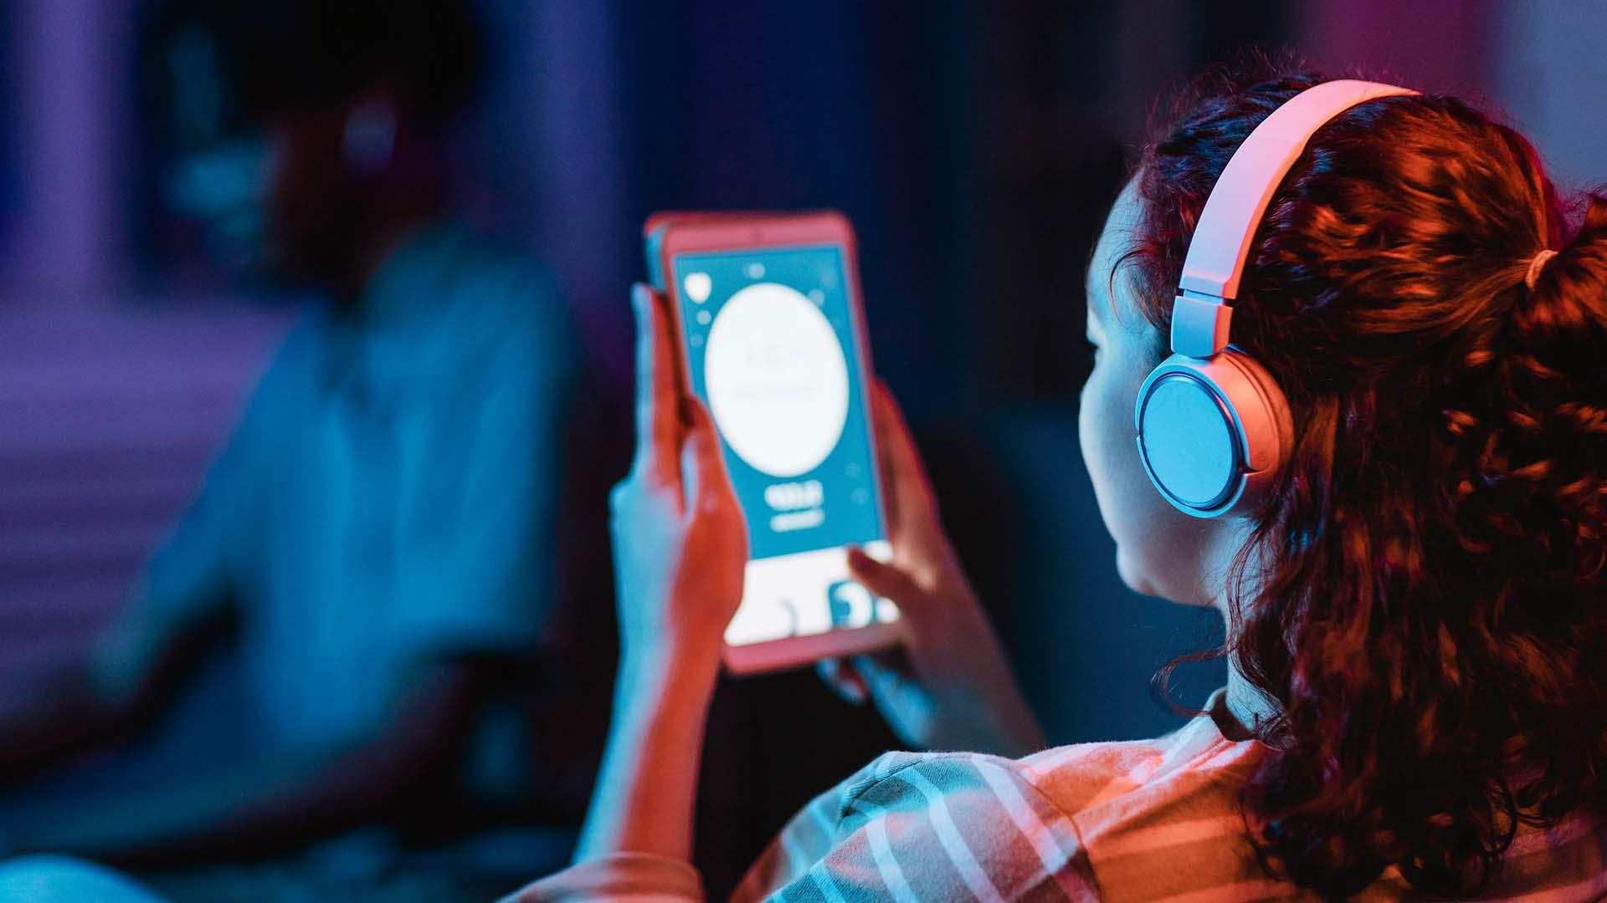
STUDY ANYTIME STUDY ANYWHERE

Slide 5
OUR OBJECTIVES- FOURFLIX
Separate/Discrete content page for each individual uploader
0 to almost no distraction for end user, only the content availed by the admin is served. (Complete control over content page)
Low cost and 0 maintenance of page – no need of separate web development or server setup.
Ease of uploading and managing content while keeping good end-user performance.
Pride of having a quality stand-alone page with rich features and quality of top OTT platforms.

Slide 6
MOTIVATION
In most big universities and colleges it becomes very hard for teachers or professors to explain and clear doubts of every student after class when the number of students are huge and specially after this pandemic situation students have become more used to learn form online videos and lecture recording which is also not getting possible now. So, here’s where FourFlix comes to light.

Slide 7

What are the existing solution to this?
In many colleges Digital lecture management is done i.e. all classrooms and galleries are equipped with pre-aligned camera setups and at the end of the day all teachers uploads their daily lectures to the college’s assigned YouTube channels and share the link with the students. So, now students can get an exact recap of the class remotely whenever they want.

Slide 8
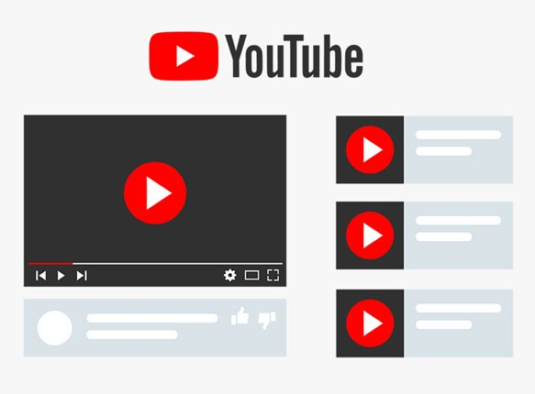
Problems in current practice:
Distraction from main content
Mix-up of educational and entertainment content
Chances of redirection to unverified content guidance
Quality can’t be achieved
High Maintainence
Big OTT platforms or Own web-page are costly

Slide 9
Our approach to it:
To alter the drawbacks and limitations of the current system what we did in FourFlix is that we gave teachers all the rich features of the other OTT platforms like: the comfort of discrete site or individual content paging with 0 to no distractions, availability of only verified content that the teacher wants to be available to his/her students but also with the ease of content management like YouTube to upload and manage the contents hassle-free. In this way both the teachers and students can enjoy the goods of both sides and cons of none.

Slide 10


PROS OF BOTH & CONS OF NONE
Ease to upload by individual entities
No maintainence cost
Distractive content
No individual paging
Individual paging
No distractive content
Upload by individual entity not possible
High maintenance cost

Slide 11
FOURFLIX DEVELOPMENT

Slide 12
Working Principle
Index.html
Venus
Starting page
If selected
Admin login
User Signup
If selected
Upload or manage
New updated link
If authentication fails
User Input
Link Generation
Home.html
Buy Plans
Updated homepage

Slide 13
SUDO-USER REQUIREMENTS
Management
DOM & SQL
No Struc Change
LAUNCH
02
04
Adition, deletion and rearrangement of content
All these basic features can be achieved easily
01
03
No change in the z-index or structure of the main site
Ready to use and sharable link for viewers

Slide 14
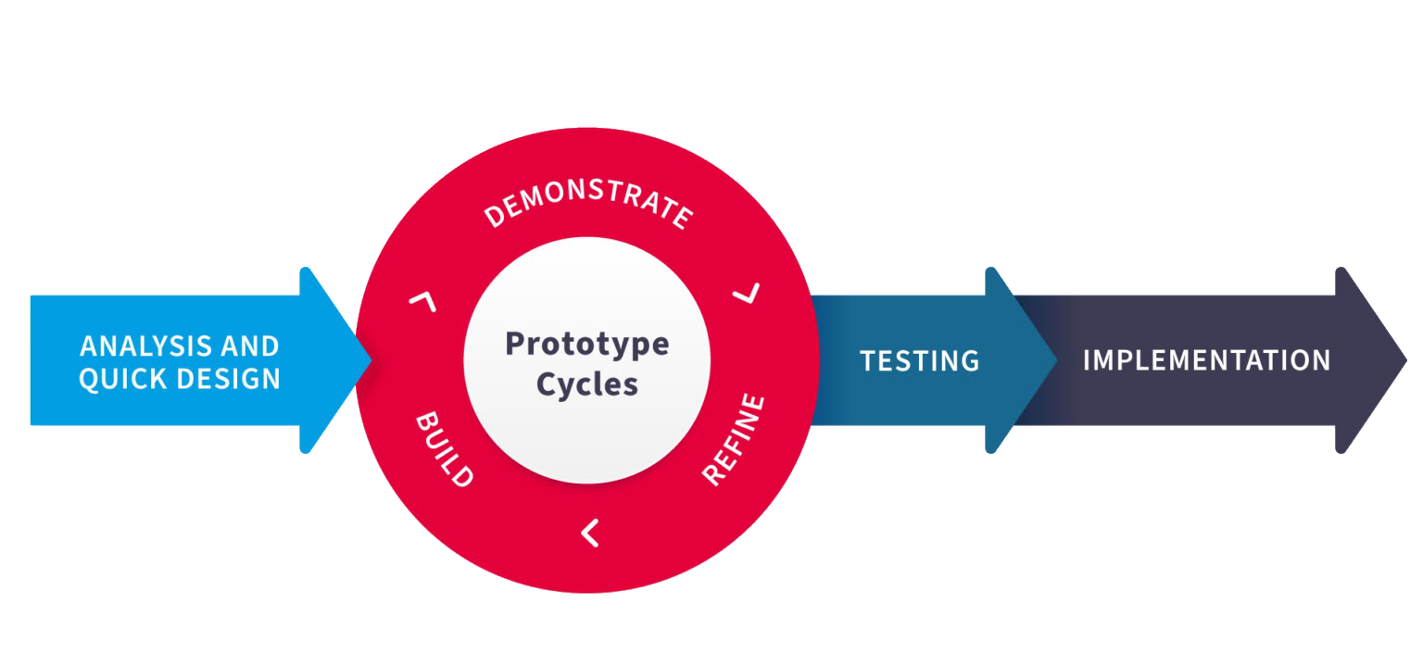
Software Development Life Cycle
RAD SDLC
MODEL USED
The best suit for projects with less complexity but
frequent content changes

Slide 15
TOOLS AND LANGUAGES
HTML
CSS
JavaScript
GIT PAGES
STRAPI
BOOTSTRAP
It is used to shape the body of site
It is used to style our website
It is used to add logic to our site
It is used to host our site temporarily
It will be used to write the back-end
It is used to add custom animations

Slide 16

Hardware and Software - REQUIREMENTS
Content Creator/Uploader
Laptop/PC with minimum specs - Linux/Windows or macOS, 1 gigahertz dual core cpu, 1 gigabyte ddr2 ram, .NET framework 4.7, any browser with WDDM 1.0 driver , 800 x 600 display output
Digital Camera with minimum 480p recording capacity
Content and Thumbnail – Max resolution 1920x1080p
YT account (Public/Unlisted) – for video links
Good Internet Connection- minimum 2mbps stable

Slide 17
Hardware and Software - REQUIREMENTS
Subscriber/Viewer
Smartphone/Tablet with minimum specs – Android/IOS, 500 megahertz dual core cpu, 500 megabyte Lpddr1 ram, Wide -vine L1 support, 5inch Display
CC’s site Link - shared by teacher
Authentication ID/PASS – account created by teacher
FourFlix Subscription if needeed
Good Internet Connection- minimum 6mbps stable for FHD output

Slide 18
DEVELOPMENT STAGES
PRE-DEVELOPMENT
OUR FUTURE PLANS
CURRENT STAGE
Static page with partial functionality and no content implementation
Complete funality for both end-user and sudo-user with admin page
Almost fully functional for end-user with all content visibility and usability

Slide 19
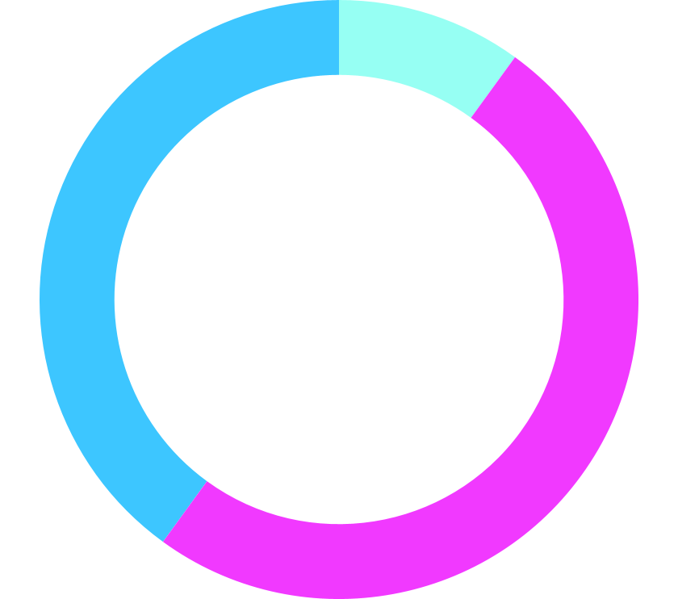
STRAPI ADVANTAGES
SPEED
60%
40%
EFFICIENCY
50%
PREDICTION
Work of hundreds of lines of code can be done with a few clicks
Big functional changes are easier to make because of modularity
Strapi makes it possible for Front-end web developers to do Full-Stack work through page linking and dashboarding of back-end with actually writing the code from scratch
Almost no chances of code-bug and error because of predictive debuging

Slide 20
REFERENCES
Although the core concept of the project is our very own creation of mind but here are some considerable references, we made use of: 1. Harvard’s CS50: Introduction to Computer Science - David J. Malan { https://pll.harvard.edu/course/cs50-introduction-computer-science?delta=0 2. Netflix, Inc. is an American subscription streaming service and production company. { https://www.netflix.com/browse 3. YouTube - YouTube is an American online video sharing and social media platform headquartered in San Bruno, California. { https://www.youtube.com/ 4. WIX - Wix.com Ltd. is an Israeli software company, publicly listed in the US, that provides cloud-based web development services. It allows users to create HTML5 websites and mobile sites through the use of online drag and drop tools. { https://www.wix.com/ 5. Full-Stack Web Development Boot Camp with HTML, CSS, JavaScript, Node, React, MongoDB, Web3 and DApps – Dr. Angela Yu https://www.udemy.com/course/the-complete-web-development-bootcamp/ 6. Complete Strapi Course by CodeWithHarry { https://www.youtube.com/playlist?list=PLu0W_9lII9ajKKSG5aROCiw9iro5vK-gE 7. Git, GitHub, & GitHub Desktop – Coder Coder YT { https://www.youtube.com/watch?v=8Dd7KRpKeaE 8. Affinity Designer Guide- Danilo Fiocco – Illustration { https://www.youtube.com/watch?v=JvC82Jl1fuA 9. Bill Gates: how online courses can radically improve education by 2030 – The Verge { https://www.youtube.com/watch?v=Hrd0NiWMIjk 10. Online learning could change academia – TED TALKS | Tyler Dewitt { https://www.youtube.com/watch?v=aGiIIGjlHg0
Because the concept was unique, we needed to learn lots of very short skills to some huge technical skills. So, it’s really hard to memorize all and make all of them present/list here at once.

Slide 21
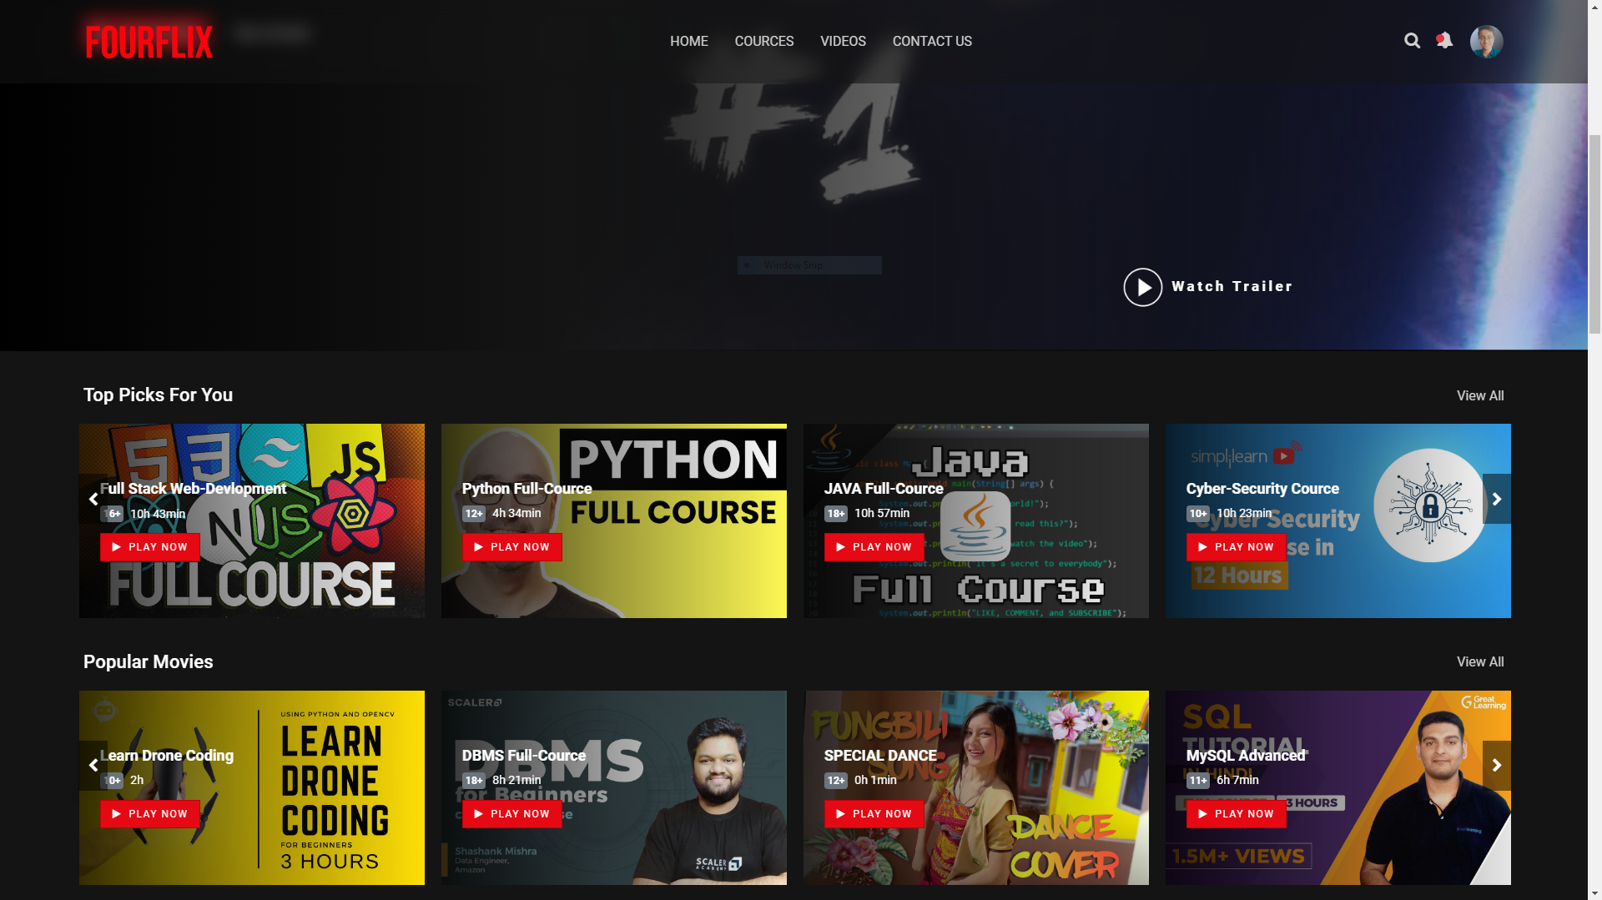

FOURFLIX LIVE DEMO
Here’s a small demo of our website- FOUFLIX, the basic features, functionalities and it’s responsiveness!

Slide 22
THANK YOU
Thanks Teacher and all respected panel members, that was all from us team fanatic four Diploma 6th semester Computer Science Dept. hope you liked 🙏
https://github.com/FalconEthics/OTT-Platform-FOURFLIX.git
©️ TEAM FANATIC 4 - 2022

